Slide 1
Studying Cosmic Reionization
Extragalactic Astrophysics and Cosmology Group Study
Seminar 12th March 2013

Slide 2
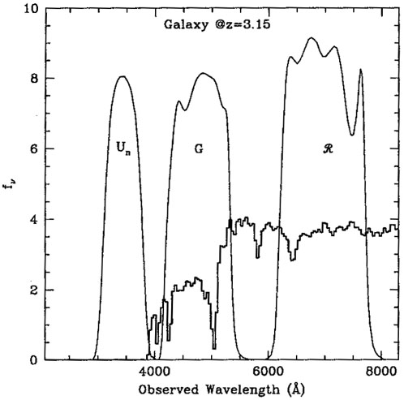
What is Colour?

Slide 3
Colour for Lyman-break galaxies
Defined as difference in magnitudes between filters
For Lyman-break galaxies, there will be a large decrease in magnitude for a band situated on the break and blue-ward of the break, due to the absorption of the flux by the Gunn-Peterson effect.
But what about Contaminants?

Slide 4
Contaminants
Photometric scatter, interlopers, (brown dwarf stars, galaxies at intermediate redshift)
To eliminate the contaminants, restrictions can be placed upon the data using another filter red-ward of the filter containing the drop
From these two colour values for each object observed, a colour-colour diagram can be made with a colour window for our target objects, eliminating most contaminants

Slide 5
Telescope filters chosen
J-W F200w Wavelength (microns) | Calculated Redshift of Lyman Break
1.61 | 12.26
1.71 | 13.09
1.81 | 13.92
1.92 | 14.75
2.02 | 15.58
2.12 | 16.40
2.22 | 17.23
2.32 | 18.06
2.42 | 18.89
2.52 | 19.72
Hubble
F105w, F125w, F160w
Can provide colour-colour diagrams for approximately z= 7.9-10
James-Webb
Able to do three band photometry for the galaxies across all redshift ranges, but will most likely be used for z>10, possibly for some range within z= 5-8
F070w, F090w F115w, F150w, F200w, F277w
E-ELT
Doesn’t have correct filters for colour selection for z= 10-15
Euclid
Y,J,H filters
Colour information only for approximately z=8.4-10
MIKE AND STON THERE WILL BE MORE FILTERS FOR JAMES WEBB AND E-ELT

Slide 6
Using the Program Hyperz
Can create a catalog of synthetic lyman-break galaxies in a particular redshift range
gives magnitude in a certain filter using transmission files using a reference filter with a certain magnitude, with a sample spectrum
Colour-colour diagram can be formed to show statistical grouping of galaxies, so a colour window can be found

Slide 7
Make_catalog
Reference filter chosen for a redshift range. Must contain observed red-shifted wavelength of the rest frame 1500A wavelength over the redshift range
Magnitude can be obtained from Predictions group from observed luminosity function of 1500A
Program then uses a sample spectrum to convert this magnitude to what it would be in other bands

Slide 8
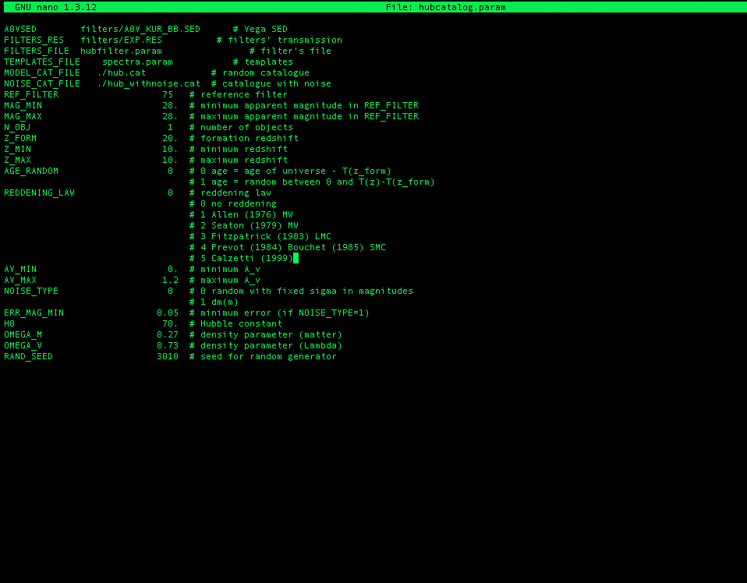
Vega Spectral Energy Distribution
Choose filters from database
Spectrum of lyman-break
Output files
Reference filter and magnitude
Number of galaxies
Redshift all galaxies were formed
Redshift range
Age of galaxies
Extinction
Cosmological parameters

Slide 9
Other Factors
Forming Redshift
Age of galaxies
Reddening law
Cosmological Parameters

Slide 10
An ‘example’ Colour-Colour diagram
Hubble z=6-8 (incorrect)

Slide 11
Aims for next couple of weeks
Find reference filters for the range of redshifts required
Produce more accurate red-shift ranges for filters
Convert magnitudes to AB from Vega
Look into the Reddening law
Produce colour-colour diagrams for redshifts 6-15

